Slide 1
Setup Ansible

Slide 2

Agenda
Installing Ansible
Setting Up Testing Server
Configure Ansible
Configure Ansible Core
Ansible Configuration FIle

Slide 3
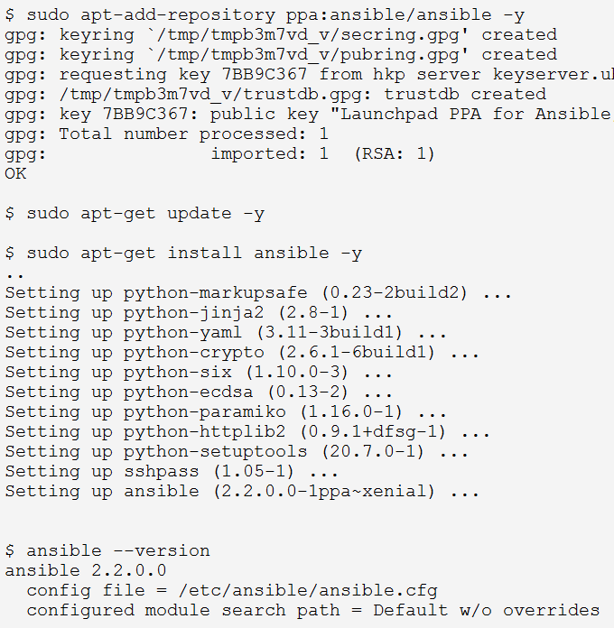
Installing Ansible
Prerequisites
Operating System:
RHEL/CentOS/Fedora
Ubuntu/Debian/Linux Mint
Jinja2
PyYAML
paramiko
httplib2
sshpass
Python 2.6 or higher
Installation Methods
via repositories (apt, yum)
via source (pip)

Slide 4




Ansible Configuration
Notes:
The settings in Ansible are adjustable via a configuration file. The stock configuration should be sufficient for most users.
Changes can be made and used in a configuration file which will be processed in the following order:

Slide 5
Ansible Configuration
forks
The default number of parallel processes to spawn when communicating with remote hosts.
host_key_checking
Host key checking is on by default and to disable it, you may do so here by setting the value to False.
sudo_user
This is the default user to sudo to if --sudo-user is not specified or ‘sudo_user’ is not specified in an Ansible playbook. The default is the most logical: ‘root’.
log_path
If present and configured in ansible.cfg, Ansible will log information about executions at the designated location. Be sure the user running Ansible has permissions on the logfile.
scp_if_ssh
Occasionally users may be managing a remote system that doesn’t have SFTP enabled. If set to True, we can cause scp to be used to transfer remote files instead.

Slide 6
General
ask_pass, ask_sudo_pass, ask_vault_pass
These settings are for prompting for passwords depending on their usage.
fact_caching, fact_caching_connection, fact_caching_timeout, fact_path
These settings are for managing facts
host_key_checking, inventory, forks
These settings are more generic one.
local_tmp, log_path, module_name
These settings are the default value of local tmp folder, log location & default module.
remote_port, remote_tmp, remote_host
Settings to manage remote hosts.
Notes:
ask_pass
This controls whether an Ansible playbook should prompt for a password by default. The default behavior is no:
ask_sudo_pass
Similar to ask_pass, this controls whether an Ansible playbook should prompt for a sudo password by default when sudoing. The default behavior is also no:
ask_vault_pass
This controls whether an Ansible playbook should prompt for the vault password by default. The default behavior is no:
fact_caching
This option allows you to configure fact caching. When a fact cache is enabled and there is valid data for a host, Ansible will use that rather than running an implicit setup job on a remote host.
fact_caching_connection
This option tells Ansible where to cache facts. The value is plugin dependent. For the jsonfile plugin, it should be a path to a local directory. For the redis plugin, the value is a host:port:database triplet:
fact_caching_timeout
This option tells Ansible when to expire values from the cache. Setting this value to 0 effectively disables expiry, and a positive value is a TTL in seconds:
fact_path
This option allows you to globally configure a custom path for Local Facts (Facts.d) for the implied setup task when using implied fact gathering.

